Slide 1
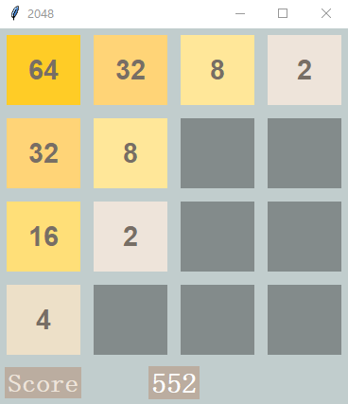
AMS 561 Group Project — 2048
Team members: Qiang Wang, Sikun Wang, Yizhen Jia

Slide 2
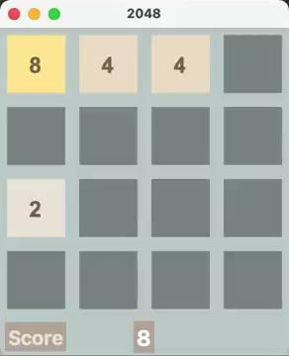
Overall Idea and significance
4*4 grid;
Open with random two blocks with 2 or 4;
Use keyboard to control;
Blocks are moving in same direction;
Two same blocks merge to their sum when colliding;
New block form per operation.
Victory goal : Get a "2048" block!

Slide 3
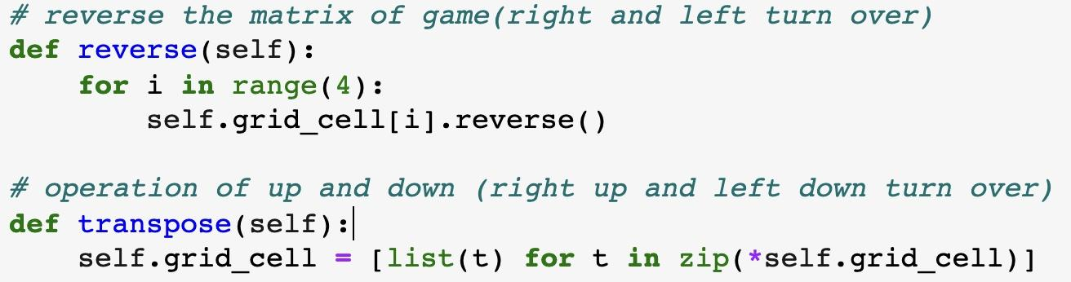
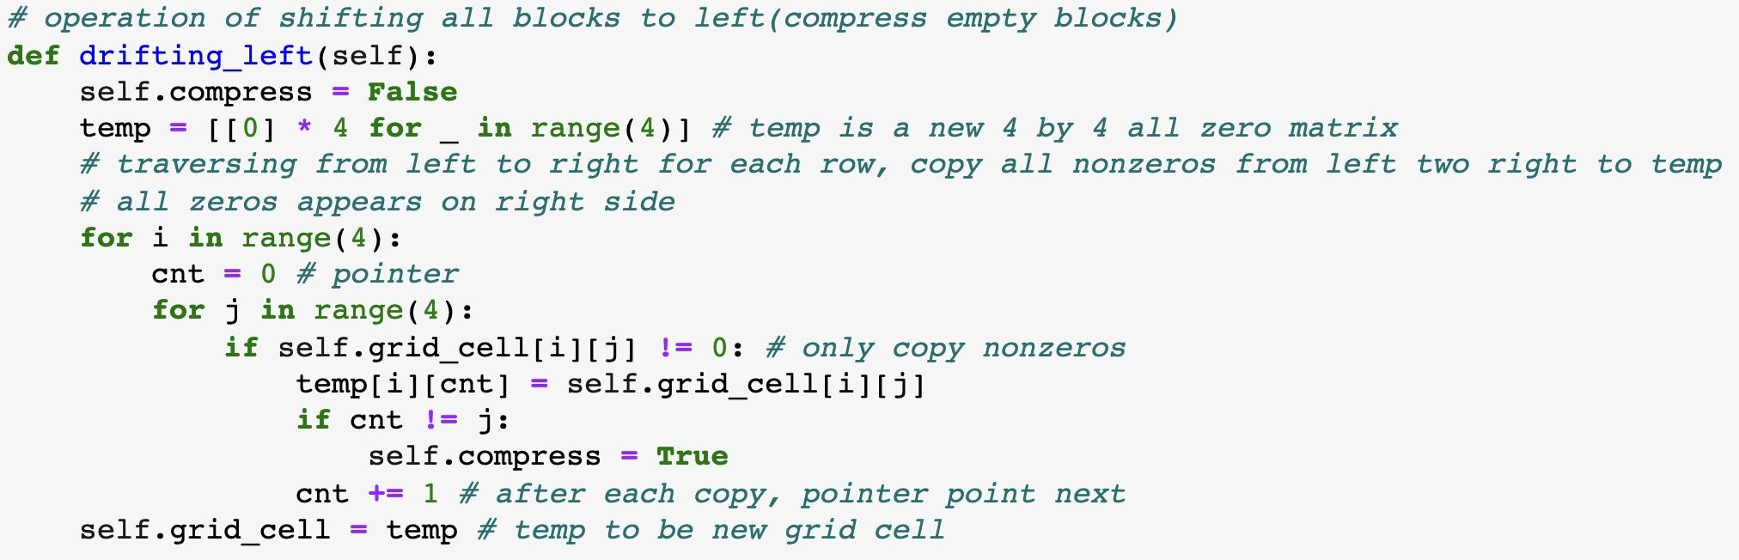
Techniques and Tools used
— reverse() and transpose() func
— drifting_left() func

Slide 4
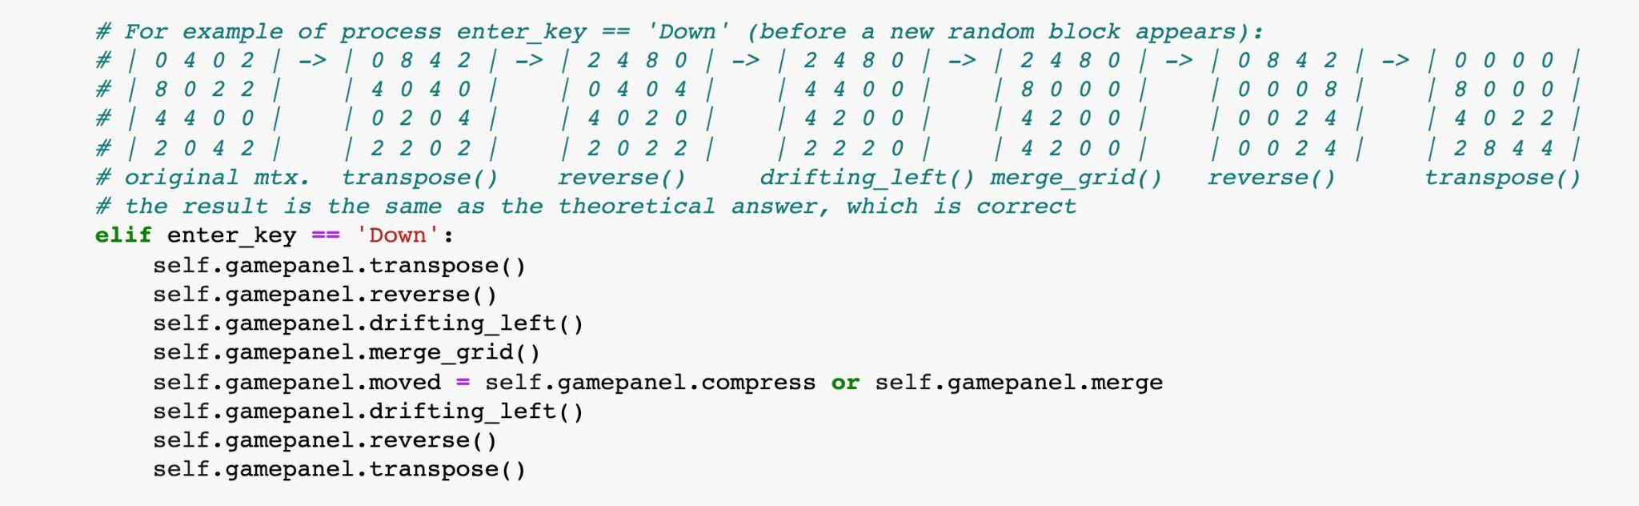
Techniques and Tools used. Cont
Application of all functions
(Example of “DOWN”)

Slide 5
Challengings and Cool thing
Original code was too messy, found a new way and connect functions using class to make it better
Scoreboard algorithm and design
Operation Sounds
Cool: Similar to the original game, but has our own essence.

Slide 6
Team expertise level and what we learned during the project
Members of the team have elementary programming skills.
Improvement of Game Algorithm Design including class, pygame, tkinter.
Resources Searching
Communicate and cooperate with each others.

